Slide 1
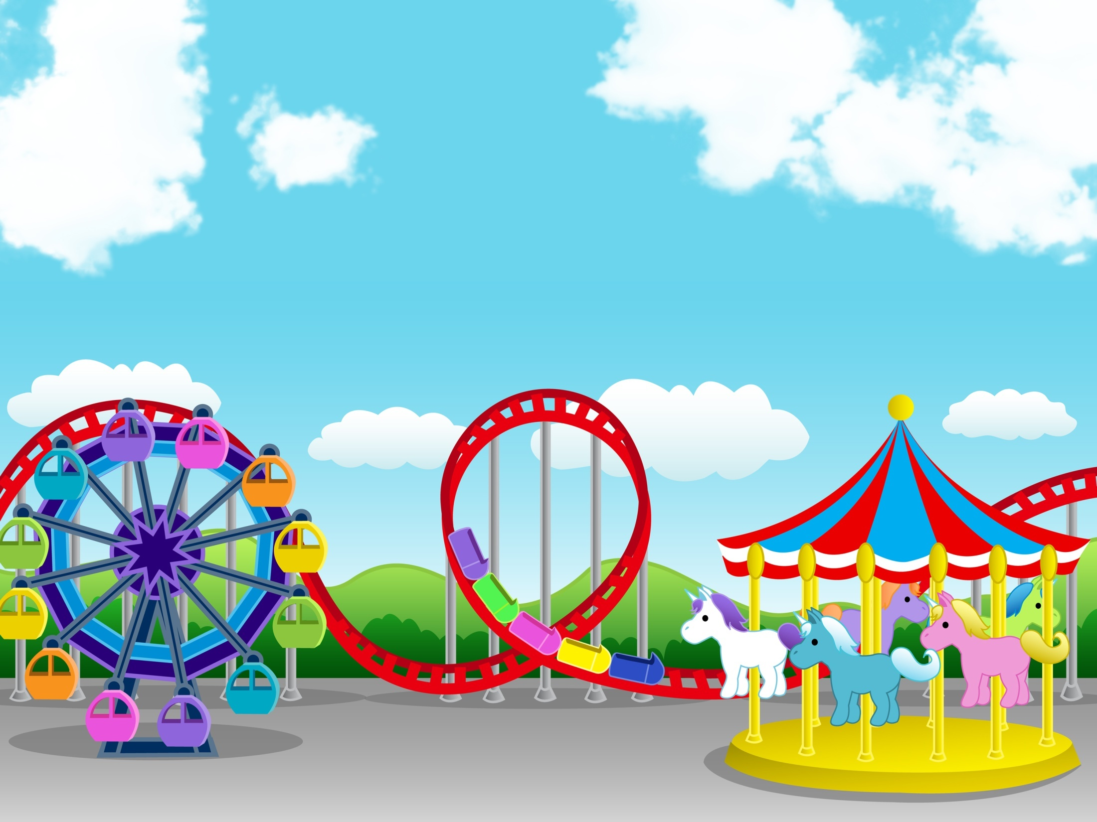
Physics in the amusement park and sports (part 2)

Slide 2
Constant Velocity
Also called uniform motion
Change in position with respect to time is constant
Zero acceleration

Slide 3
Position
x = x_{o} + v t
x_{o} = initial velocity
x
v = slope
x_{o}
t
x vs t is linear

Slide 4
Constant/ UNIFORM Acceleration
Motion with constant change in velocity
Two cases:
Uniformly accelerated rectilinear motion (UARM) – varying speed, constant direction
Uniform Circular Motion (UCM)– constant speed, varying direction

Slide 5
Uniformly Accelerated Rectilinear Motion
Motion with constant acceleration in 1D.
Velocity constantly changes with time

Slide 6
POSITION
x = x₀ + v₀t + ½ at²
x
x₀ = initial position
v₀ = initial velocity
t
Position changes with time in parabolic manner

Slide 7
VELOCITY
v = v₀+ at
v
t
V vs t is linear

Slide 8
VELOCITY
v² = v₀²+2aΔx
Δx = change in position
Velocity as function of position

Slide 9
EX 1 : Race Car
From rest, a race car accelerated at 8 m/s² for 10 seconds. a) What is the position of the car at the end of the 10 seconds? b) What is the velocity of the car at the end of the 10 seconds?

Slide 10
Answer
Given:
V_{o} = 0 m/s (rest)
X_{o} = 0 m (reference)
a = 8 m/s²
t = 10 s
1) x = x₀ + v₀t + ½ at²
x = 0 m + (0 m/s)(10s) +
½ (8 m/s²)(10²)
x = 400 m

Slide 11
Answer
Given:
V_{o} = 0 m/s (rest)
X_{o} = 0 m (reference)
a = 8 m/s²
t = 10 s
2) v = v₀+ at
v = (0 m/s) + (8 m/s²)(10m/s)
v = 80 m/s

Slide 12
EX 2 : Don’t drink and …
A train is travelling at 40m/s when the operator sees a drunk person passed out on the tracks 100 m away.
a) What is the acceleration is needed to so that the train doesn’t run over the drunk person? b) How much time does it take the train to stop completely?

Slide 13
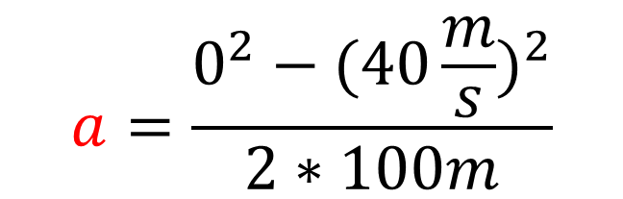
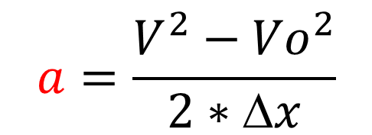
Answer
Vo=40 m/s
V = 0 m/s
train
Δx =100 m
person
a) v² = v₀²+2aΔx
$$a=\frac{V^{2}−{Vo}_{}^{2}}{2∗Δx}$$
$$a=\frac{0^{2}−{(40\frac{m}{s})}_{}^{2}}{2∗100m}$$
a = -8 m/s²

Slide 14
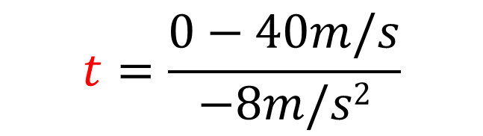
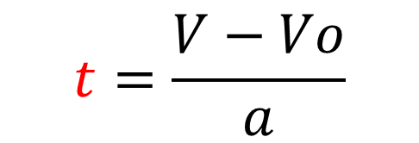

Answer
Vo=40 m/s
V = 0 m/s
a = 8 m/s²
train
person
b) v = v₀+ at
$$t=\frac{V−Vo}{a}$$
$$t=\frac{0−40m/s}{−8m/s2}$$
$$t=5 s$$

Slide 15

Example of uniformly accelerated motion
FREE FALL !!!

Slide 16
Free Fall
Body moving under the sole influence of gravity
Neglect other factors such as air resistance

Slide 17
Free Fall
Body moving at a constant acceleration.
g = acceleration due to gravity
g = -9.8 m/s²,
Negative implies downward direction

Slide 18
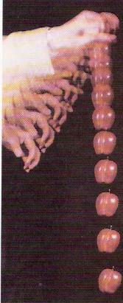
Acceleration
Independent of mass
The value of g varies slightly with latitude and with elevation.
At sea level in Earth's mid-latitudes the value of g is 9.8 m/s², downward
g

Slide 19
Fall Faster
According to freefall model, which will fall faster, a 50 kg stone or a 0.01 g feather?
Ans: They will fall at the SAME time. Freefall is independent of mass

Slide 20
Limitation of freefall
Does not take into consideration the effect of size, shape, and mass of falling objects

Slide 21
Formula
Use formula for constant acceleration
1) x = x₀ + v₀t + ½ at²
y = y₀ + v₀t - ½ gt²

Slide 22
Formula
2) v = v₀+ at
v = v₀- gt

Slide 23
Formula
3) v² = v₀²+2aΔx
v² = v₀²-2gΔy

Slide 24
ACTIVITY
FREEFALL OR NOT ???

Slide 25
MECHANICS
State whether the following is an example of freefall or not.
Assumptions
Neglect air resistance

Slide 26
1. A ball fell downward
FREEFALL
Consider the time after the ball was released from the hand of the thrower

Slide 27
2. A ball thrown downward with initial velocity
Consider the time after the ball was released from the hand of the thrower

Slide 28
2. A ball thrown downward with initial velocity
FREEFALL
After the ball was released from the hand, NO other forces acts on it except gravity

Slide 29
3. A ball thrown upward with initial velocity
Consider the time after the ball was released from the hand of the thrower

Slide 30
3. A ball thrown upward with initial velocity
FREEFALL
After the ball was released from the hand, NO other forces acts on it except gravity

Slide 31
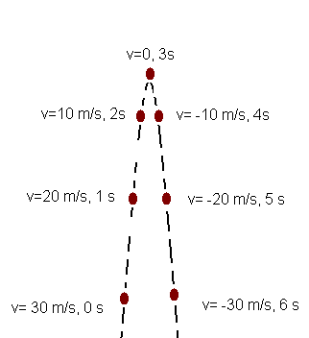
Tossing a ball
Highest point → V = 0 m/s
V↓ = -
V↑ = +
a = ↓
a = ↓
Time up = time down

Slide 32
TRUE OR FALSE
An object thrown downwards has a greater acceleration than an object thrown upwards
Ans: FALSE
The acceleration is the same

Slide 33
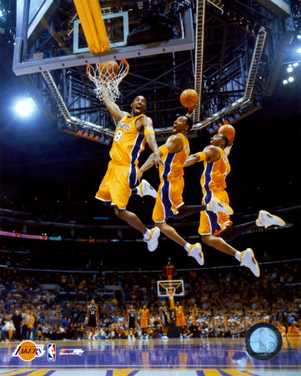
Basketball
Kobe Bryant jumps up to take a shot. If his total hang time lasts 1 second, how high did he jump?
www.howcelebritiesloseweight.com

Slide 34
Answer
V = 0 m/s
Height = ???
V₀ = ??? m/s
Total time = 1s
Time up = time down = 0.5 s
Compute the initial velocity, then height

Slide 35
Answer
V = 0 m/s
Time up = 0.5 s
Height = ???
V₀ = ??? m/s
initial velocity, Vo ???
v = v₀- gt
v₀= v+ gt
v₀= 0 + 9.8m/s²(0.5s)
v₀= 4.9 m/s

Slide 36
Height?
v² = v₀²- 2gh
h = v₀² / 2g
h = (4.9m/s) ² / 2 (9.8 m/s²)
h = 1.225m

Slide 37
4. A ball thrown sideward
Consider the time after the ball was released from the hand of the thrower

Slide 38
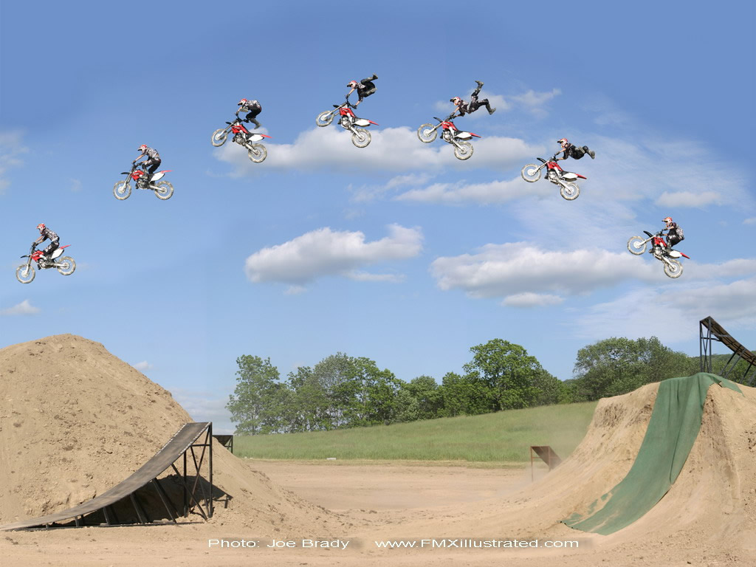
sites.google.com/site/anrosphysics/ib-physics/topic-9-motion-in-fields-1/1-projectile-motion

Slide 39
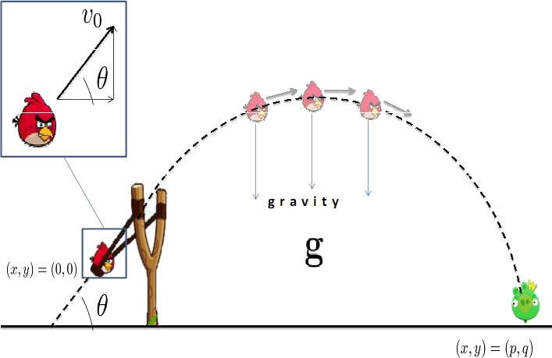
PROJECTILE MOTION
Motion which is determined entirely by the effect of gravity.

Slide 40
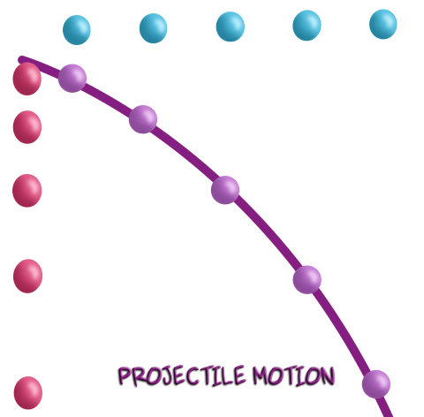
PROJECTILE MOTION
x -component
Constant velocity
Y -component
Freefall (1D)
(Constant Acceleration)

Slide 41
Assumptions:
the free-fall acceleration g is constant over the range of motion and is directed downward
the effect of air resistance is negligible

Slide 42
Projectile Motion
Projectile- object being launched or projected
Trajectory - path of projectile motion; usually a parabola

Slide 43
Projectile Motion
Initial velocity
Height
Range- horizontal displacement

Slide 44
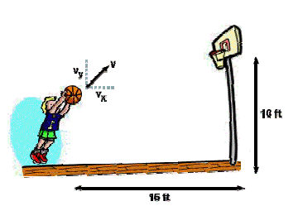
Initial Velocity

Slide 45
Initial velocity
V_{o}
V_{y} = V_{o}sin θ
θ
θ
V_{x} =V_{o}cos θ

Slide 46
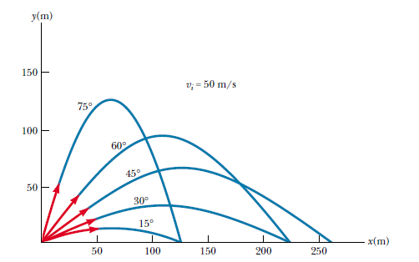
Projectile Motion
Highest Height (θ = 90°)
Farthest Range
(θ = 45°)
90°

Slide 47
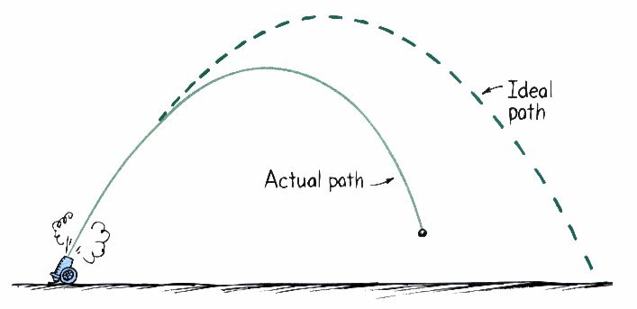
With air resistance
fall short of the parabolic path

Slide 48
Fall first at the bottom?
Vo = 0 m/s
θ = 0°
V_{ox} = 5 m/s
V_{oy} = 0 m/s
H = 5m
H = 5m
a
b

Slide 49
Answer
Vo = 0 m/s
θ = 0°
V_{ox} = 5 m/s
V_{oy} = 0 m/s
Same!!! They have the same initial velocity along the y-axis which is zero.

Slide 50
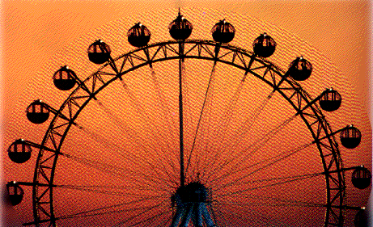
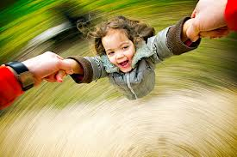
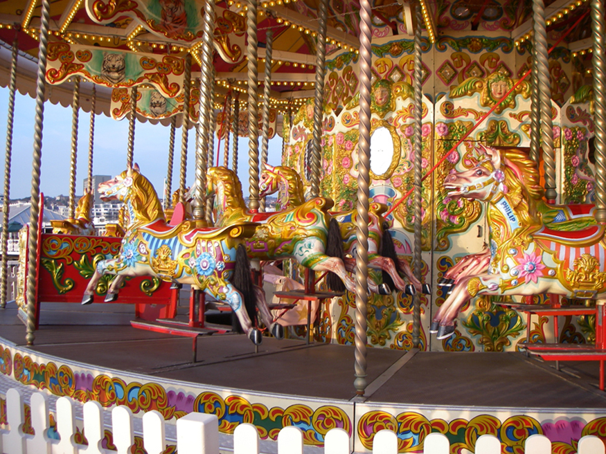
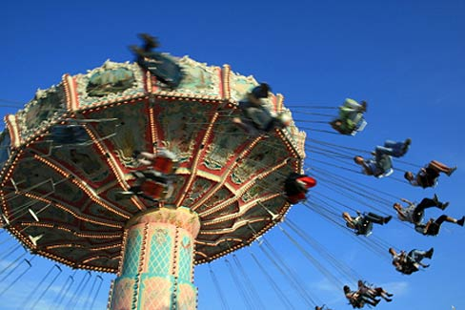
www.apartmenttherapy.com
cnx.org
cnx.org
1912bungalow.com

Slide 51
UNIFORM CIRCULAR MOTION (UCM)
Motion around a circle with constant speed.
It is accelerating because the direction is constantly changing
Velocity is not constant

Slide 52
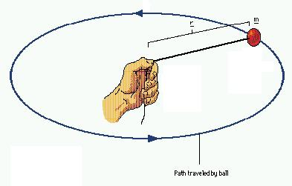
Centripetal Acceleration, a_{c}
The acceleration needed to keep an object moving in circular motion

Slide 53
Centripetal Acceleration
has constant magnitude throughout the entire UCM
Direction: towards the center of the circular path
v
a_{c}

Slide 54
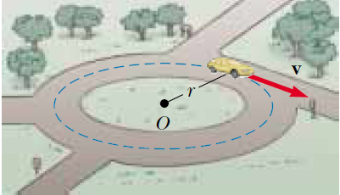
Velocity
tangent to the path
perpendicular to the radius and centripetal acceleration

Slide 55
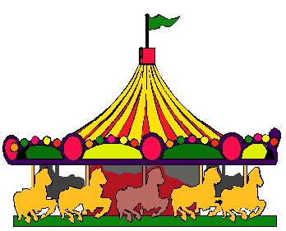
Centripetal Acceleration, a_{c}
v = speed
r = radius

Slide 56
Period (T)
Time of one complete revolution
v = speed
r = radius

Slide 57
Exercise
In a carnival ride, the passengers travel at constant speed in a circle of radius 5.0m. They make one complete circle in 4.0s. What is their velocity and acceleration?
GIVEN:
radius= 5.0 m
Period(T)= 4.0 s
v and a = ?

Slide 58
SOLUTION :
T= 2πR
v

Slide 59
SOLUTION :

